Slide 1
Introduction to Programming
Spring 2022
Notes:
4/3/22

Slide 2
Functions
Quick Review of Objects
Example Program: Cannonball
Defining New Classes
Data Processing with Class
Objects and Encapsulation
Widgets
Animated Cannonball
CSCI 1410
Dr. Salim Lakhani
/
Notes:
4/3/22

Slide 3
Quick Review of Objects
In chapters 6, 7, and 8 we developed techniques for structuring the computations of the program.
  Functions
  Decision structures
  Loop Structures
We’ll now take a look at techniques for structuring the data that our programs use.
So far, our programs have made use of objects created from pre-defined classes such as Circle.
In this chapter we’ll learn how to write our own classes to create novel objects.
CSCI 1410
Dr. Salim Lakhani
/
Notes:
4/3/22

Slide 4
Quick Review of Objects
In chapter 4 an object was defined as an active data type that knows stuff and can do stuff.
More precisely, an object consists of:
A collection of related information.
A set of operations to manipulate that information.
CSCI 1410
Dr. Salim Lakhani
/
Notes:
4/3/22

Slide 5
Quick Review of Objects
The information is stored inside the object in instance variables.
The operations, called methods, are functions that “live” inside the object.
Collectively, the instance variables and methods are called the attributes of an object.
CSCI 1410
Dr. Salim Lakhani
/
Notes:
4/3/22
We can use the IPO model
Function for input
Function for processing
Function for output

Slide 6
Quick Review of Objects
A Circle object will have instance variables such as center, which remembers the center point of the circle, and radius, which stores the length of the circle’s radius.
The draw method examines the center and radius to decide which pixels in a window should be colored.
CSCI 1410
Dr. Salim Lakhani
/
Notes:
4/3/22

Slide 7
Quick Review of Objects
The move method will change the value of center to reflect the new position of the circle.
All objects are said to be an instance of some class.
The class of an object determines which attributes the object will have.
A class is a description of what its instances will know and do.
CSCI 1410
Dr. Salim Lakhani
/
Notes:
4/3/22

Slide 8
Quick Review of Objects
New objects are created from a class by invoking a constructor.
You can think of the class itself as a sort of factory for stamping out new instances.
Consider making a new circle object:
myCircle = Circle(Point(0,0),20)
Circle, the name of the class, is used to invoke the constructor.
CSCI 1410
Dr. Salim Lakhani
/
Notes:
4/3/22

Slide 9
Quick Review of Objects
myCircle = Circle(Point(0,0), 20)
This statement creates a new Circle instance and stores a reference to it in the variable myCircle.
The parameters to the constructor are used to initialize some of the instance variables (center and radius) inside myCircle.
CSCI 1410
Dr. Salim Lakhani
/
Notes:
4/3/22

Slide 10
Quick Review of Objects
myCircle = Circle(Point(0,0), 20)
Once the instance has been created, it can be manipulated by calling on its methods:
myCircle.draw(win)
myCircle.move(dx,dy)
We can also get information about the object by using its methods.
myCircle.getCenter()
myCircle.getRadius()
CSCI 1410
Dr. Salim Lakhani
/
Notes:
4/3/22
The formal parameter is assigned the value of the actual parameter. It’s as if the following statement had been executed:
x = y
Note that variable x was just initialized

Slide 11
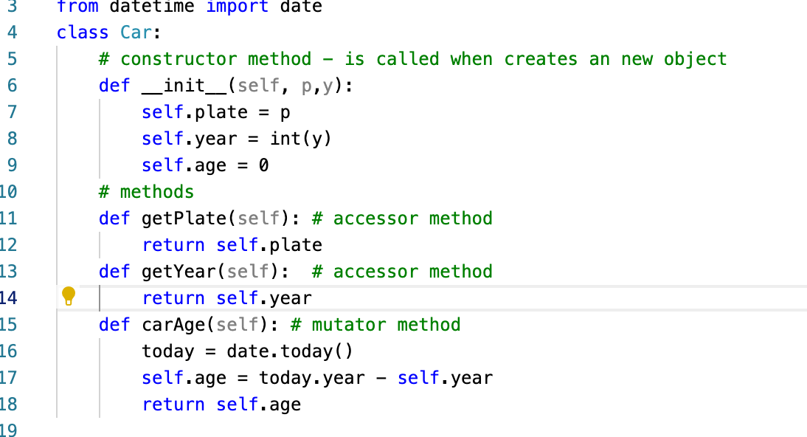
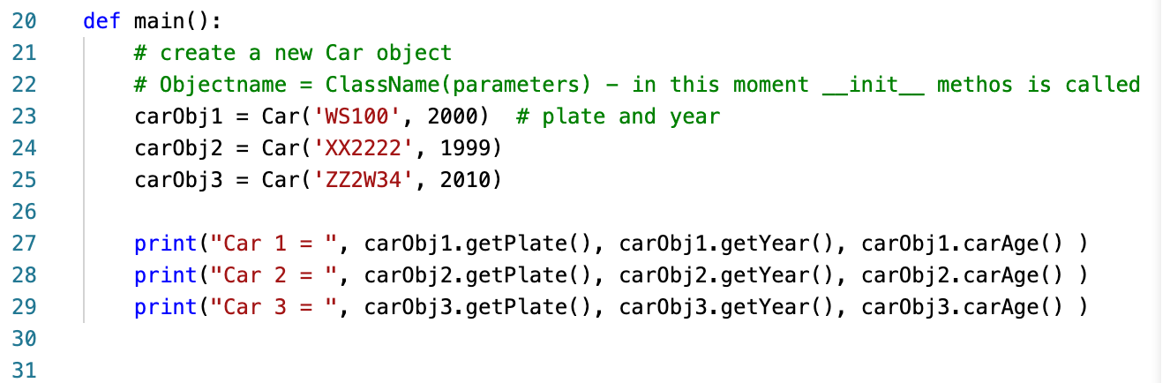
Let's Create a simple Class Car

Slide 12
Cannonball Program Specification
Let’s try to write a program that simulates the flight of a cannonball or other projectile.
We’re interested in how far the cannonball will travel when fired at various launch angles and initial velocities.
The input to the program will be the launch angle (in degrees), the initial velocity (in meters per second), and the initial height (in meters) of the cannonball.
The output will be the distance that the projectile travels before striking the ground (in meters).
CSCI 1410
Dr. Salim Lakhani
/
Notes:
4/3/22

Slide 13
Cannonball Program Specification
The acceleration of gravity near the earth’s surface is roughly 9.8 m/s/s.
If an object is thrown straight up at 20 m/s, after one second it will be traveling upwards at 10.2 m/s. After another second, its speed will be .4 m/s. Shortly after that the object will start coming back down to earth.
CSCI 1410
Dr. Salim Lakhani
/
Notes:
4/3/22

Slide 14
Cannonball Program Specification
Using calculus, we could derive a formula that gives the position of the cannonball at any moment of its flight.
However, we’ll solve this problem with simulation, a little geometry, and the fact that the distance an object travels in a certain amount of time is equal to its rate times the amount of time (d = rt).
CSCI 1410
Dr. Salim Lakhani
/
Notes:
4/3/22

Slide 15
Designing the Program
Given the nature of the problem, it’s obvious we need to consider the flight of the cannonball in two dimensions: it’s height and the distance it travels.
Let’s think of the position of the cannonball as the point (x, y) where x is the distance from the starting point and y is the height above the ground.
CSCI 1410
Dr. Salim Lakhani
/
Notes:
4/3/22

Slide 16
Designing the Program
Suppose the ball starts at position (0,0), and we want to check its position every tenth of a second.
In that time interval it will have moved some distance upward (positive y) and some distance forward (positive x). The exact distance will be determined by the velocity in that direction.
Since we are ignoring wind resistance, x will remain constant through the flight.
However, y will change over time due to gravity. The y velocity will start out positive and then become negative as the cannonball starts to fall.
CSCI 1410
Dr. Salim Lakhani
/
Notes:
4/3/22
When Python gets to this loop
I is not defined and it is a syntex error
Once I is initialied to 0
i is equal to 0, which is less than 10, so the body of the loop is executed, printing 0. Now control returns to the condition, and since i is still 0, the loop repeats, etc.
This is an example of an infinite loop.

Slide 17
Designing the Program
Input the simulation parameters: angle, velocity, height, interval.
Calculate the initial position of the cannonball: xpos, ypos
Calculate the initial velocities of the cannonball: xvel, yvel
While the cannonball is still flying:
  Update the values of xpos, ypos, and yvel for interval seconds further into the flight
Output the distance traveled as xpos
CSCI 1410
Dr. Salim Lakhani
/
Notes:
4/3/22
>>> 3 < 4
True
>>> 3 * 4 < 3 + 4
False
>>> "hello" == "hello"
True
>>> "Hello" < "hello"
True
>>> 'apples' == 'apple'
False
>>> 'apples' > 'apple'
True
>>> 'apples' < 'apple'
False
>>>

Slide 18
Designing the Program
Using step-wise refinement:
def main():
# Step 1
angle =
float(input("Enter the launch angle (in degrees): "))
vel =
float(input("Enter the initial velocity (in meters/sec): "))
h0 = float(input("Enter the initial height (in meters): "))
time =
float(input("Enter the time interval between position calculations: "))
CSCI 1410
Dr. Salim Lakhani
/
Notes:
4/3/22

Slide 19
Designing the Program
Step 2: Calculating the initial position for the cannonball is also easy. It’s at distance 0 and height h0!
xpos = 0
ypos = h0
CSCI 1410
Dr. Salim Lakhani
/
Notes:
4/3/22

Slide 20

Designing the Program
Step 3:
If we know the magnitude of the velocity and the angle theta, we can calculate
yvel=velocity*sin(theta) and
xvel=velocity*cos(theta)
CSCI 1410
Dr. Salim Lakhani
/
Notes:
4/3/22

Slide 21
Designing the Program
Our input angle is in degrees, and the Python math library uses radians.
theta = math.radians(angle)
xvel = vel * math.cos(theta)
yvel = vel * math.sin(theta)
CSCI 1410
Dr. Salim Lakhani
/
Notes:
4/3/22

Slide 22
Designing the Program
Step 4: Loop:
while the cannonball is still flying:
What does it means?
CSCI 1410
Dr. Salim Lakhani
/
Notes:
4/3/22

Slide 23
Designing the Program
Step 4: Loop:
while the cannonball is still flying:
What does it means?
Cannonball will be flying as long as ypos (distance from the ground >= 0.0
We use ypos >= 0 becauase initial height can be 0!
while ypos >=0:
CSCI 1410
Dr. Salim Lakhani
/
Notes:
4/3/22

Slide 24
Designing the Program
Inside the loop – Each time through loop we want to calculate xpos, ypos, yvel
CSCI 1410
Dr. Salim Lakhani
/
Notes:
4/3/22

Slide 25
Designing the Program
Since we assume there is no wind resistance, xvel remains constant.
Say a ball is traveling at 30 m/s and is 0 m from the firing point.
In one second it will be 30 meters away.
If the time increment is .1 second it will be 30*.1 = 53 meters distant.
xpos = xpos + time * xvel
CSCI 1410
Dr. Salim Lakhani
/
Notes:
4/3/22

Slide 26
Designing the Program
Working with yvel is slightly more complicated since gravity causes the y-velocity to change over time.
Each second, yvel must decrease by 9.8 m/s, the acceleration due to gravity.
In 0.1 seconds the velocity will decrease by 0.1(9.8) = .98 m/s.
The velocity at the end of the time interval:
yvel1 = yvel – time * 9.8
CSCI 1410
Dr. Salim Lakhani
/
Notes:
4/3/22

Slide 27
Designing the Program
To calculate how far the cannonball travels over the interval, we need to calculate its average vertical velocity over the interval.
Since the velocity due to gravity is constant, it is simply the average of the starting and ending velocities times the length of the interval:
ypos = ypos + time * (yvel + yvel1)/2.0
CSCI 1410
Dr. Salim Lakhani
/
Notes:
4/3/22

Slide 28
Designing Programs
# cball1.py
# Simulation of the flight of a cannon ball (or other projectile)
# This version is not modularized.
from math import pi, sin, cos
def main():
angle = float(input("Enter the launch angle (in degrees): "))
vel = float(input("Enter the initial velocity (in meters/sec): "))
h0 = float(input("Enter the initial height (in meters): "))
time = float(input("Enter the time interval between position calculations: "))
radians = (angle * pi)/180.0
xpos = 0
ypos = h0
xvel = vel * cos(radians)
yvel = vel * sin(radians)
while ypos >= 0:
xpos = xpos + time * xvel
yvel1 = yvel - 9.8 * time
ypos = ypos + time * (yvel + yvel1)/2.0
yvel = yvel1
print("\nDistance traveled: {0:0.1f} meters." .format(xpos)
CSCI 1410
Dr. Salim Lakhani
/
Notes:
4/3/22

Slide 29
Modularizing the Program
During program development, we employed step-wise refinement (and top-down design), but did not divide the program into functions.
While this program is fairly short, it is complex due to the number of variables.
CSCI 1410
Dr. Salim Lakhani
/
Notes:
4/3/22

Slide 30
Modularizing the Program
def main():
angle, vel, h0, time = getInputs()
xpos, ypos = 0, h0
xvel, yvel = getXYComponents(vel, angle)
while ypos >= 0:
xpos, ypos, yvel = updateCannonBall(time, xpos, ypos, xvel, yvel)
print("\nDistance traveled: {0:0.1f} meters.".format(xpos)
It should be obvious what each of these helper functions does based on their name and the original program code.
CSCI 1410
Dr. Salim Lakhani
/
Notes:
4/3/22
>>> bool(0)
False
>>> bool(1)
True
>>> bool(32)
True
>>> bool("Hello")
True
>>> bool("")
False
>>> bool([1,2,3])
True
>>> bool([])
False

Slide 31
Modularizing the Program
This version of the program is more concise!
The number of variables has been reduced from 10 to 8, since theta and yvel1 are local to getXYComponents and updateCannonBall, respectively.
This may be simpler, but keeping track of the cannonball still requires four pieces of information, three of which change from moment to moment!
CSCI 1410
Dr. Salim Lakhani
/
Notes:
4/3/22
x and y – if x is false return false otherwise return y
x o r y – if x is true return true, otherwise return Y
not X – If X is false return True, otherwise return False

Slide 32
Modularizing the Program
All four variables, plus time, are needed to compute the new values of the three that change.
This gives us a function with five parameters and three return values.
Yuck! There must be a better way!
CSCI 1410
Dr. Salim Lakhani
/
Notes:
4/3/22

Slide 33
Modularizing the Program
There is a single real-world cannonball object, but it requires four pieces of information:
xpos, ypos, xvel, and yvel.
Suppose there was a Projectile class that “understood” the physics of objects like cannonballs. An algorithm using this approach would create and update an object stored in a single variable.
CSCI 1410
Dr. Salim Lakhani
/
Notes:
4/3/22

Slide 34
Modularizing the Program
Using our object-based approach:
def main():
angle, vel, h0, time = getInputs()
cball = Projectile(angle, vel, h0)
while cball.getY() >= 0:
cball.update(time)
print("\nDistance traveled: {0:0.1f} meters.".format(cball.getX()))
To make this work we need a Projectile class that implements the methods update, getX, and getY.
CSCI 1410
Dr. Salim Lakhani
/
Notes:
4/3/22

